Slide 1
Cohesion & Coupling, Polymorphism, Regex
by Tony Gaddis and Godfrey Muganda

Slide 2
Coupling & Cohesion
Cohesion and Coupling deal with the quality of an OO design. Generally, good OO design should be loosely coupled and highly cohesive. Lot of the design principles, design patterns which have been created are based on the idea of “Loose coupling and high cohesion”.
11-<number>

Slide 3
Coupling & Cohesion
The aim of the design should be to make the application:
easier to develop
easier to maintain
easier to add new features
less Fragile
11-<number>

Slide 4
Coupling
Coupling is the degree to which one class knows about another class. Let us consider two classes class A and class B. If class A knows class B through its interface only i.e it interacts with class B through its API then class A and class B are said to be loosely coupled.
If on the other hand class A apart from interacting class B by means of its interface also interacts through the non-interface stuff of class B then they are said to be tightly coupled. Suppose the developer changes the class B‘s non-interface part i.e non API stuff then in case of loose coupling class A does not breakdown but tight coupling causes the class A to break.
11-<number>

Slide 5
Coupling
So its always a good OO design principle to use loose coupling between the classes i.e all interactions between the objects in OO system should use the APIs. An aspect of good class and API design is that classes should be well encapsulated.
11-<number>

Slide 6
Cohesion
Cohesion is used to indicate the degree to which a class has a single, well-focused purpose. Coupling is all about how classes interact with each other, on the other hand cohesion focuses on how single class is designed. Higher the cohesiveness of the class, better is the OO design.
Benefits of Higher Cohesion:
Highly cohesive classes are much easier to maintain and less frequently changed.
Such classes are more usable than others as they are designed with a well-focused purpose.
11-<number>

Slide 7
Cohesion
Single Responsibility principle (SRP) aims at creating highly cohesive classes.
SRP states:
-There should never be more than one reason for a class to change
11-<number>

Slide 8
Cohesion - SRP
Why is that this principle is required?
Imagine designing classes with more than one responsibility/implementing more than one functionality. There’s no one stopping you to do this. But imagine the amount of dependency your class can create within itself in the due course of the development time. So when you are asked to change a certain functionality, you are not really sure how it would impact the other functionalities implemented in the class. The change might or might not impact other features, but you really can’t take risk, especially in production applications. So you end up testing all the dependent features.
11-<number>

Slide 9
Polymorphism
A reference variable can reference objects of classes that are derived from the variable’s class.
  GradedActivity exam;
We can use the exam variable to reference a GradedActivity object.
  exam = new GradedActivity();
The GradedActivity class is also used as the superclass for the FinalExam class.
An object of the FinalExam class is a GradedActivity object.
11-<number>

Slide 10
Polymorphism
A GradedActivity variable can be used to reference a FinalExam object.
  GradedActivity exam = new FinalExam(50, 7);
This statement creates a FinalExam object and stores the object’s address in the exam variable.
This is an example of polymorphism.
The term polymorphism means the ability to take many forms.
In Java, a reference variable is polymorphic because it can reference objects of types different from its own, as long as those types are subclasses of its type.
11-<number>

Slide 11
Polymorphism
Other legal polymorphic references:
  GradedActivity exam1 = new FinalExam(50, 7);
  GradedActivity exam2 = new PassFailActivity(70);
  GradedActivity exam3 = new PassFailExam(100, 10, 70);
The GradedActivity class has three methods: setScore, getScore, and getGrade.
A GradedActivity variable can be used to call only those three methods.
  GradedActivity exam = new PassFailExam(100, 10, 70);
  System.out.println(exam.getScore()); // This works.
  System.out.println(exam.getGrade()); // This works.
  System.out.println(exam.getPointsEach()); // ERROR!
11-<number>

Slide 12
Polymorphism and Dynamic Binding
If the object of the subclass has overridden a method in the superclass:
  If the variable makes a call to that method the subclass’s version of the method will be run.
  GradedActivity exam = new PassFailActivity(60);
  exam.setScore(70);
  System.out.println(exam.getGrade());
Java performs dynamic binding or late binding when a variable contains a polymorphic reference.
The Java Virtual Machine determines at runtime which method to call, depending on the type of object that the variable references.
11-<number>

Slide 13
Polymorphism
It is the object’s type, rather than the reference type, that determines which method is called.
Example:
  Polymorphic.java
You cannot assign a superclass object to a subclass reference variable.
11-<number>

Slide 14
Abstract Classes
An abstract class cannot be instantiated, but other classes are derived from it.
An Abstract class serves as a superclass for other classes.
The abstract class represents the generic or abstract form of all the classes that are derived from it.
A class becomes abstract when you place the abstract key word in the class definition.
  public abstract class ClassName
11-<number>

Slide 15
Abstract Methods
An abstract method has no body and must be overridden in a subclass.
An abstract method is a method that appears in a superclass, but expects to be overridden in a subclass.
An abstract method has only a header and no body.
  AccessSpecifier abstract ReturnType MethodName(ParameterList);
Example:
  Student.java, CompSciStudent.java, CompSciStudentDemo.java
11-<number>

Slide 16
Abstract Methods
Notice that the key word abstract appears in the header, and that the header ends with a semicolon.
  public abstract void setValue(int value);
Any class that contains an abstract method is automatically abstract.
If a subclass fails to override an abstract method, a compiler error will result.
Abstract methods are used to ensure that a subclass implements the method.
11-<number>

Slide 17
Interfaces
An interface is similar to an abstract class that has all abstract methods.
  It cannot be instantiated, and
  all of the methods listed in an interface must be written elsewhere.
The purpose of an interface is to specify behavior for other classes.
An interface looks similar to a class, except:
  the keyword interface is used instead of the keyword class, and
  the methods that are specified in an interface have no bodies, only headers that are terminated by semicolons.
11-<number>

Slide 18
Interfaces
The general format of an interface definition:
  public interface InterfaceName
  {
  (Method headers...)
  }
All methods specified by an interface are public by default.
A class can implement one or more interfaces.
11-<number>

Slide 19
Interfaces
If a class implements an interface, it uses the implements keyword in the class header.
  public class FinalExam3 extends GradedActivity implements Relatable
Example:
  GradedActivity.java
  Relatable.java
  FinalExam3.java
  InterfaceDemo.java
11-<number>

Slide 20
Fields in Interfaces
An interface can contain field declarations:
  all fields in an interface are treated as final and static.
Because they automatically become final, you must provide an initialization value.
  public interface Doable
  {
  int FIELD1 = 1, FIELD2 = 2;
  (Method headers...)
  }
In this interface, FIELD1 and FIELD2 are final static int variables.
Any class that implements this interface has access to these variables.
11-<number>

Slide 21
Implementing Multiple Interfaces
A class can be derived from only one superclass.
Java allows a class to implement multiple interfaces.
When a class implements multiple interfaces, it must provide the methods specified by all of them.
To specify multiple interfaces in a class definition, simply list the names of the interfaces, separated by commas, after the implements key word.
  public class MyClass implements Interface1,
  Interface2,
  Interface3
11-<number>

Slide 22
Interfaces in UML
GradedActivity
A dashed line with an arrow indicates implementation of an interface.
FinalExam3
Relatable
11-<number>

Slide 23
Polymorphism with Interfaces
Java allows you to create reference variables of an interface type.
An interface reference variable can reference any object that implements that interface, regardless of its class type.
This is another example of polymorphism.
Example:
  RetailItem.java
  CompactDisc.java
  DvdMovie.java
  PolymorphicInterfaceDemo.java
11-<number>

Slide 24
Polymorphism with Interfaces
In the example code, two RetailItem reference variables, item1 and item2, are declared.
The item1 variable references a CompactDisc object and the item2 variable references a DvdMovie object.
When a class implements an interface, an inheritance relationship known as interface inheritance is established.
  a CompactDisc object is a RetailItem, and
  a DvdMovie object is a RetailItem.
11-<number>

Slide 25
Polymorphism with Interfaces
A reference to an interface can point to any class that implements that interface.
You cannot create an instance of an interface.
  RetailItem item = new RetailItem(); // ERROR!
When an interface variable references an object:
  only the methods declared in the interface are available,
  explicit type casting is required to access the other methods of an object referenced by an interface reference.
11-<number>

Slide 26
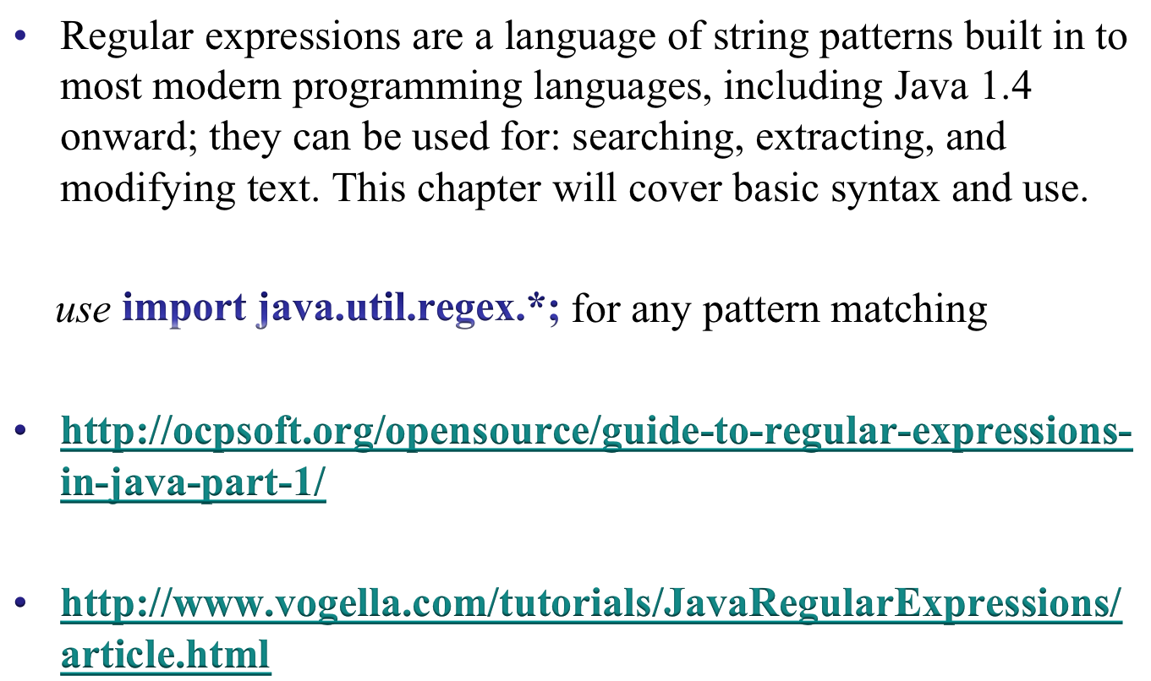
Regexpressions & Java
11-<number>

